Slide 1
Regularization in Neural Networks
By Muhammad Atif Tahir
Some Slides from Ismini Lourentzou Hung-yi Lee
Andrew Ng (Coursera)

Slide 2
Acknowledgments
This presentation is heavily based on: https://visualstudiomagazine.com/articles/2017/0 9/01/neural-network-l2.aspx
https://towardsdatascience.com/regularization- in-deep-learning-l1-l2-and-dropout- 377e75acc036
… and many other

Slide 3
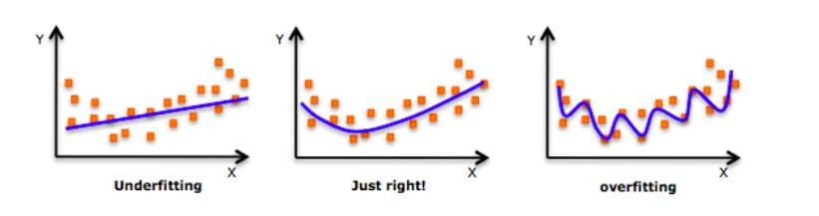
Background
As move towards right, poor performance on unseen data

Slide 4
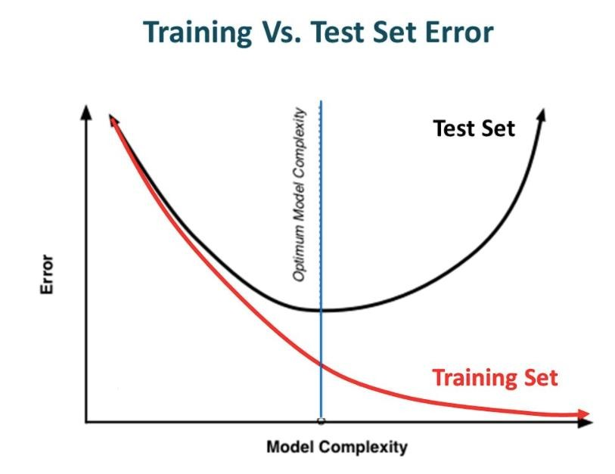

Slide 5
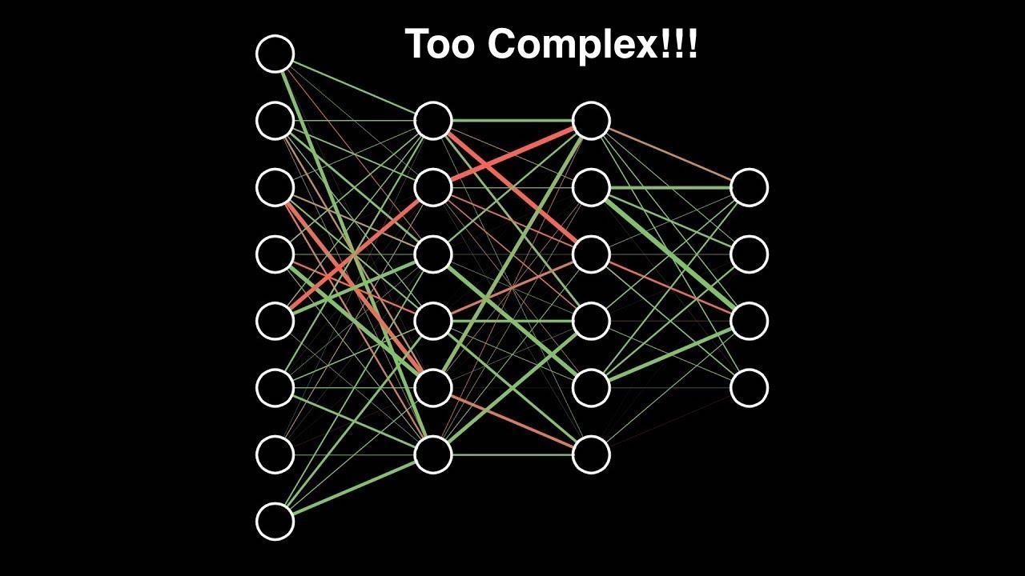

Slide 6
What is Regularization
0 Regularization is a technique which makes slight modifications to the learning algorithm such that the model generalizes better
0 This in turn improves the model’s performance
on the unseen data as well

Slide 7
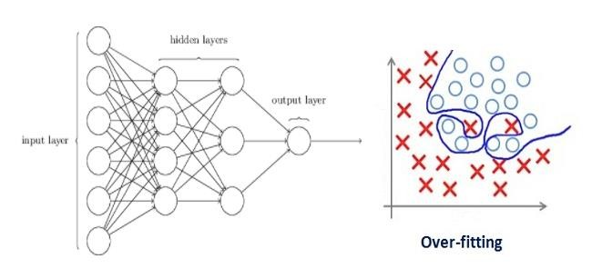
Why Regularization

Slide 8
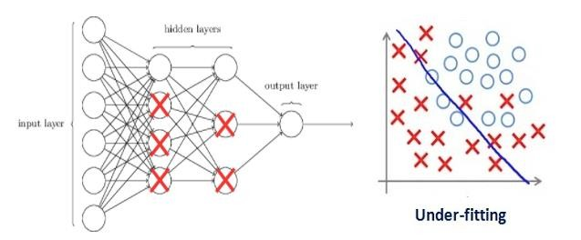
Why Regularization
In machine learning, regularization penalizes the coefficients
In deep learning, it actually penalizes the weight matrices of the nodes
Assume that our regularization coefficient is so high that some of the
weight matrices are nearly equal to zero
This will result in a much simpler linear network and slight underfitting of the training data.

Slide 9
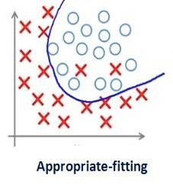
Why Regularization
Such a large value of the regularization coefficient is not that useful
We need to optimize the value of regularization coefficient in order to obtain a well-fitted model as shown in the image below

Slide 10
Read Neural Network L2 Regularization Using Python -- Visual Studio Magazine.pdf
Read Neural Network L1 Regularization Using Python -- Visual Studio Magazine.pdf

Slide 11
Drop Out
0 Deep-Learning-Seminar-Dropout.ppt
0 https://www.cs.toronto.edu/~hinton/absps/JML Rdropout.pdf
0 Cited by 23000 (by 10/09/2020); Journal of ML Research
0 Regularization of Neural Networks using DropConnect
0 ICML 2013

Slide 12
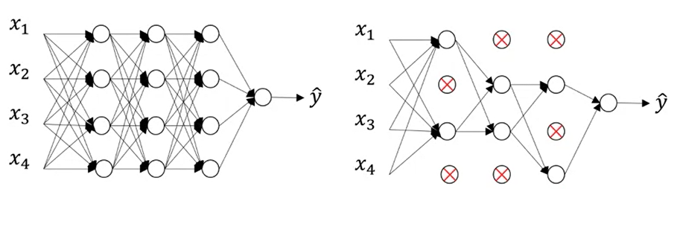
Go through each of the layers of the network and set some probability of eliminating a node in neural network.

Slide 13
For different training examples, you zero out different hidden units. When you make multiple passes through the same training set, then on different passes through the training set, you should randomly zero out different hidden units.
Inverted Dropout
On average, since you end up with some units shut, the value of z is going to be reduced by the rate of dropout.
So, in order to not reduce the expected value of z, you need to divide the activations by (1-dropout_rate) because this will correct or just a bump up the activations by roughly the same amount
Dropout only used at training time, not at test time

Slide 14
Intuition is that drop out randomly knocks out units in the network. So it's as if on every iteration you're working with a smaller and different neural network
The inputs can get randomly eliminated. So the output of a particular neuron can't rely on any one feature because any of the features could go away at random or anyone of its own inputs could go away at random, so it will need to spread out the incoming weights to different neurons rather than one some particular ones
Also feasible to vary dropout rate by layer

Slide 15
Keras
model = Sequential()
model.add(Dropout(0.2, input_shape=(100,)))
model.add(Dense(30, activation='relu')
model.add(Dropout(0.2))
model.add(Dense(1, activation='sigmoid'))

Slide 16
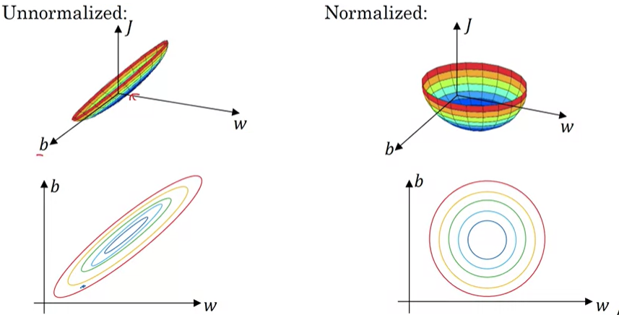
Normalization
Cost function shapes:

Slide 17
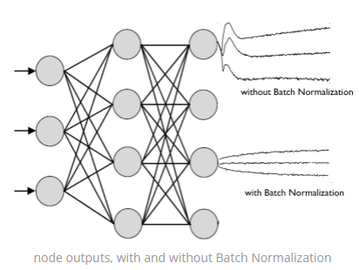

Slide 18
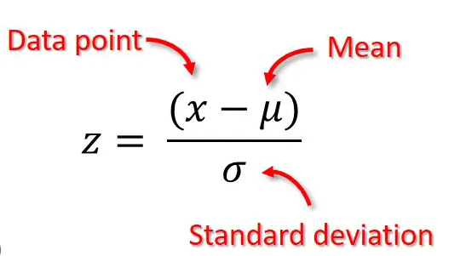
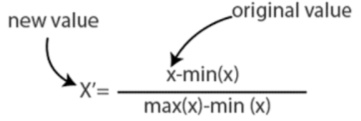

Slide 19
Batch Normalization(BN)
Batch Normalization focuses on standardizing the inputs to any particular layer(i.e. activations from previous layers). Standardizing the inputs mean that inputs to any layer in the network should have approximately zero mean and unit variance. Mathematically, BN layer transforms each input in the current mini-batch by subtracting the input mean in the current mini-batch and dividing it by the standard deviation.
Layer Normalization(LN)
Inspired by the results of Batch Normalization, Geoffrey Hinton et al. proposed Layer Normalization which normalizes the activations along the feature direction instead of mini-batch direction. This overcomes the cons of BN by removing the dependency on batches and makes it easier to apply for RNNs as well.
In essence, Layer Normalization normalizes each feature of the activations to zero mean and unit variance.

Slide 20
Data Augmentation
Data augmentation is a technique of artificially increasing the training set by creating modified copies of a dataset using existing data.
Can be used to:
To prevent models from overfitting.
The initial training set is too small.
To improve the model accuracy.
To Reduce the operational cost of labeling and cleaning the raw dataset.
Note: The biases in the original dataset persist in the augmented data or can even get exagerated.

Slide 21
Augmentation techniques
Text Data Augmentation
Synonyms, Random spelling mistakes, additions, subtractions, sentence shuffling, etc.
Image Augmentation
Sharpening or blurring, changing colors, flip, crop, rotate, zoom, re-sizing, etc.
Audio Data Augmentation
Changing the speed, pitch, etc.
Using GANs…..

Slide 22

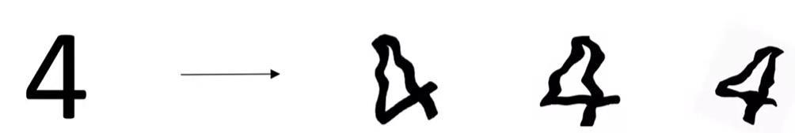
Data Augmentation

Slide 23
Why Data Augmentation
0 http://ai.stanford.edu/blog/data- augmentation/

Slide 24
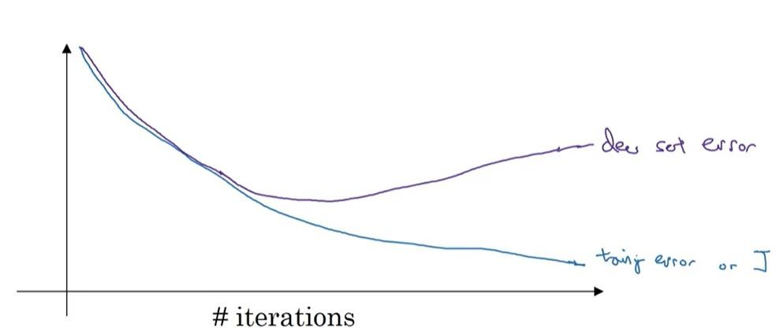
Early Stopping

Slide 25
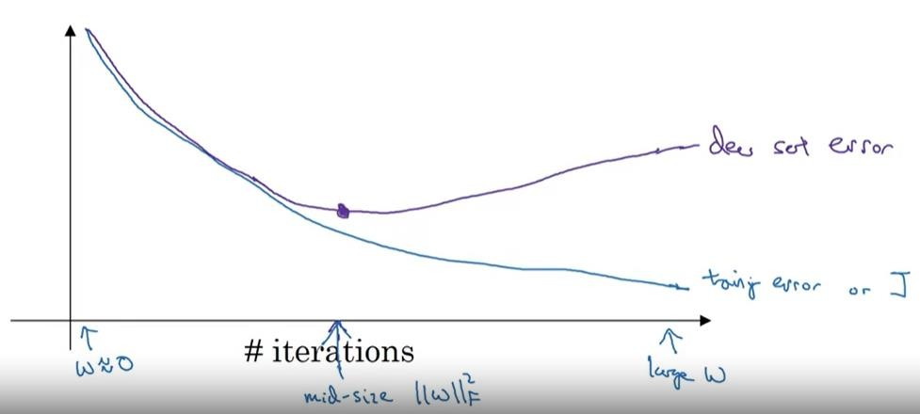
Early Stopping

Slide 26
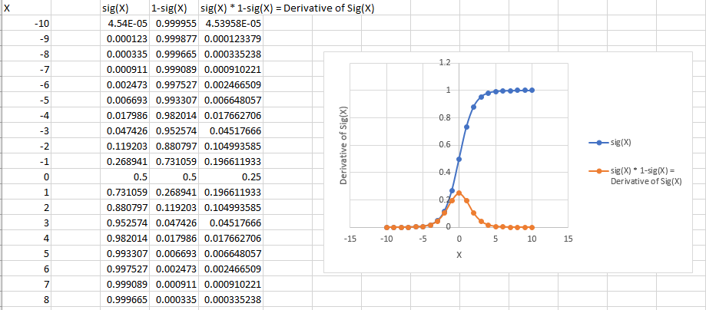
Vanishing Gradient

Slide 27
Exploding gradient
This problem is due to the initial weights assigned to the neural nets creating large losses. Big gradient values can accumulate to the point where large parameter updates are observed, causing gradient descents to oscillate without coming to global minima.

Slide 28
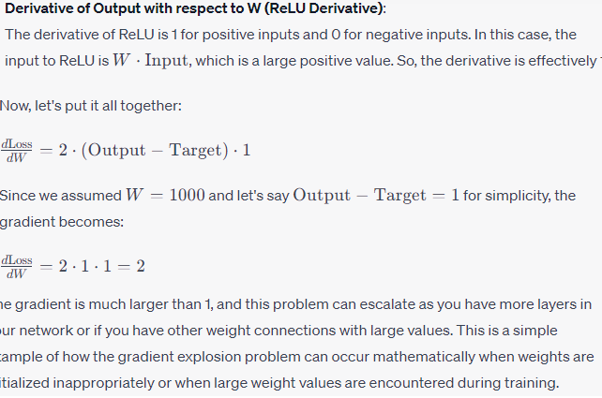

Slide 29


